Slide 1
NEO4J CYPHER TUTORIAL WITH PYTHON
Create Node In Neo4j Graph Using Apoc Procedure & Python
Tutorial 95

Slide 2
Use case
Create Node In Neo4j Graph Using Apoc Procedure & Python

Slide 3
Pre-requisites
apoc.import.file.enabled=true
apoc.import.file.use_neo4j_config=false

Slide 4
Create Node In Neo4j Graph Using Apoc Procedure & Python
CALL apoc.create.node(["Student"],{NAME:"BOB",CLASS:"HIGH"})
Code written in neo4j browser

Slide 5
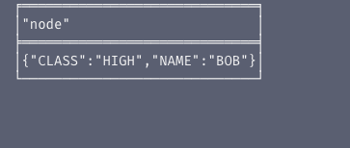
output
From neo4j browser

Slide 6
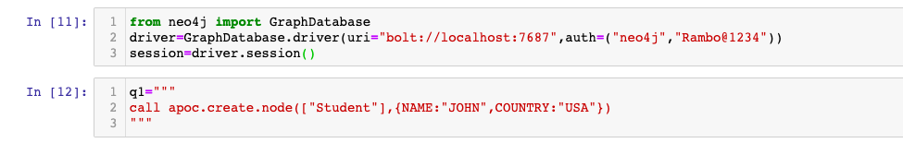
Create Node In Neo4j Graph Using Apoc Procedure & Python
Code written in python ide

Slide 7
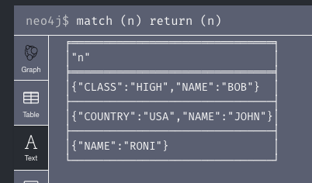
output
From python ide

Slide 8
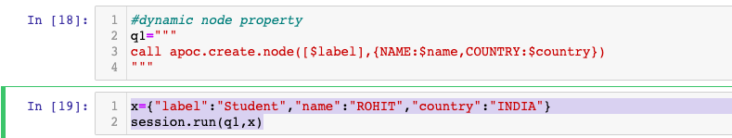
Create Node (with dynamic property)In Neo4j Graph Using Apoc Procedure & Python
Code written in python ide

Slide 9
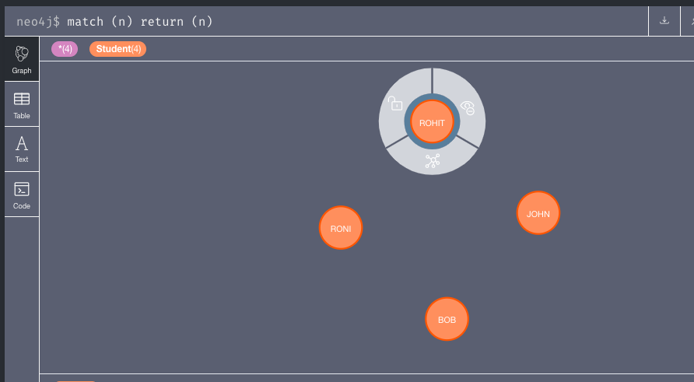
output
From python ide

